Slide 1
Introduction to C++

Slide 2
Facebook Group
www.facebook.com/groups/pst.community.eg

Slide 3
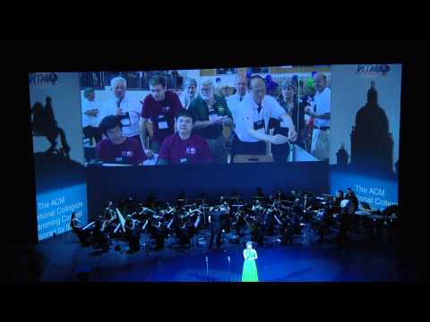

Slide 4
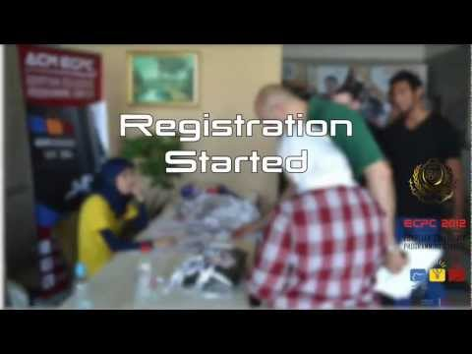

Slide 5
Agenda
Intro.
Conditions.

Slide 6
Introduction
Phases of C++ Program:
Edit: write your program in any IDE (integrated development environment) like Microsoft Visual Studio, Eclipse,…etc. Editing produces a .cpp file.
Preprocess: C++ preprocessor obeys special commands called preprocessor directives. This usually consists of including other files to compile with our project files. e.g.: # include <iostream> is a preprocessor directive that include I/O functions from library iostream to our project. The preprocessor is invoked by the compiler before the program is converted to machine language.
Compile: The compiler translates the .cpp file into machine language code, also called object code (.obj file). The compiler also indicates syntax errors in the program.

Slide 7
Introduction (cont.)
Link: a C++ program may contain reference to functions defined elsewhere by other programmers or vendors. Linker links the .obj file with the code of the functions to produce a .exe file, ready for execution.
Load and execute: Finally go and run the program through loading the program and its data into memory and running the .exe file.

Slide 8
Important Terms
A source program (.cpp file type) consists of the program statements comprising a C++ or other programming language program.
An object program (.obj file type) is the result of compiling a source program.
Header files (.h file type) contain constant, variable, and function declarations needed by a program.
An executable program is a program that can be run by a computer.
Linking adds code from libraries to your file. Collects the object code from all files in the workspace and puts them into one executable program.
A compiler is a program that translates a source program into an object program.
An interpreter is a program that translates individual source program statements, one at a time, into executable statements. Each statement is executed immediately after translation.

Slide 9
Compiler vs. Interpreter
A compiler first takes in the entire program, checks for errors, compiles it and then executes it.
Languages like Assembly Language, C, C++, Fortran, Pascal are compiled into machine code.
Longer process than that of an interpreter but program runs faster.
An interpreter does this line by line, so it takes one line, checks it for errors and then executes it.
Languages like Basic, VbScript and JavaScript are interpreted.
interpreted programs run much slower than compiled programs, as much as 5-10 times slower as every line of code has to be re-read, then re-processed.

Slide 10
Errors
Syntax Errors – Typing Errors
Errors in programming language rules.
You can use the compiler or interpreter to uncover syntax errors.
You must have a good working knowledge of error messages to discover the cause of the error.
Semantic Errors – Logic or Meaning Errors
Errors that indicate the logic used when coding the program failed to solve the problem.
You do not get error messages with logic errors.
Your only clue to the existence of logic errors is the production of wrong solutions.
Run-time Errors (Exceptions)
Code does something illegal when it is run (hence runtime) E.g., divide by zero

Slide 11
C++ is case sensitive
“google” and “GoogLe” are different

Slide 12
C++ Hello World!
#include <iostream>
using namespace std;
int main() {
cout << "Hello World!" << endl;
return 0;
}

Slide 13
Common mistakes
find the error(s):
#include “iostream”
using namespace std
int main {
cout << "Hello World!" << endl;
return 0;

Slide 14
Variables
Used to store values in memory.
When naming a variable you should consider the following:
is a sequence of one or more letters (a-z) (A-Z), digits (0-9) or underscore characters (_).
Neither spaces nor punctuation marks or symbols can be part of a variable name.
In addition, variable names always have to begin with a letter.
Another rule that you have to consider when naming a variable is that they cannot match any keyword of the C++ language nor your compiler's specific ones.

Slide 15
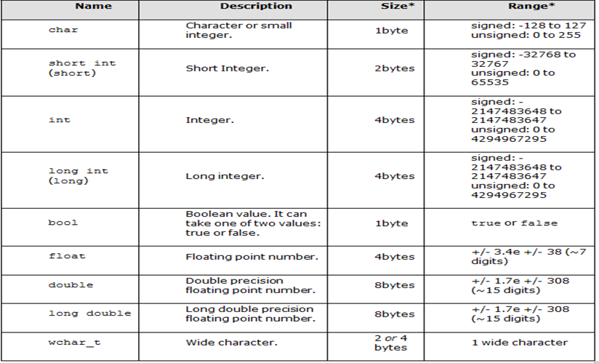
Data Types

Slide 16
Declaring Variables
int a;
double d;
int x, y, z; same to: int x; int y; int z;
unsigned short int usi;

Slide 17
Declaring and Initializing Variables
Initialization: is to give your variable an initial value at the beginning of the program.
int sum = 0;
int multiplication = 1;
int counter = 100;

Slide 18
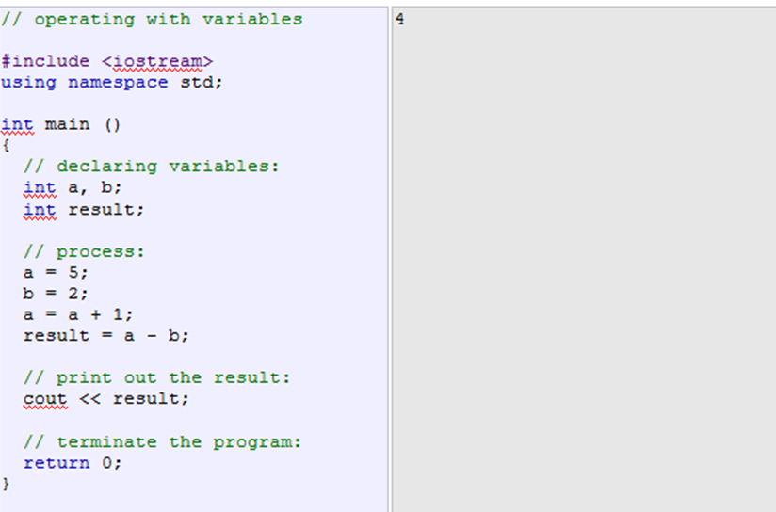
Example

Slide 19
Assignment (=)
The assignment operator assigns the value of the right side to the variable and only one variable of the left side.
sum = 10;
sum = sum + 10 * 7 / 2;

Slide 20
Arithmetic Operators ( + - * / % )
Order of precedence of arithmetic operators:
( )
* / %
-
L
O
W
E
R

Slide 21
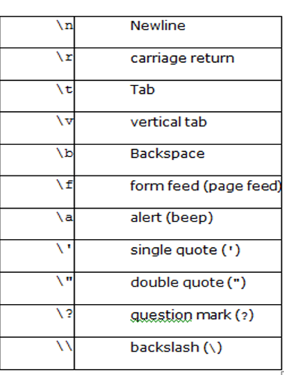
List of escape sequences
cout << “Hello” << endl;
same to
cout << “Hello\n”;

Slide 22
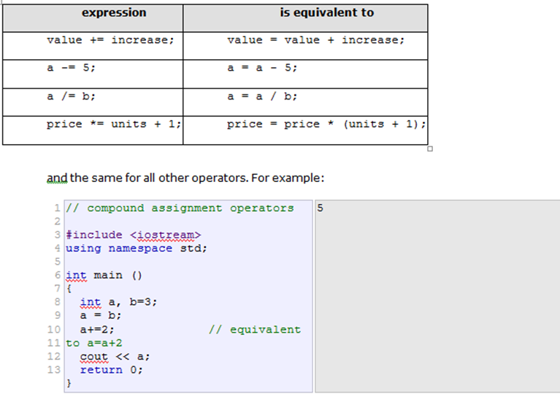
Compound Assignment ( += | -= | %= | *= | /= )

Slide 23
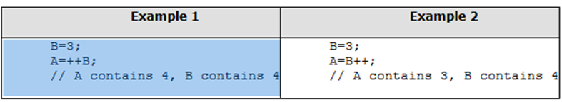
Increment and Decrement ( ++ | --)
++ increments the value by 1
-- decrements the value by 1
++B differs from B++

Slide 24
Standard Input (Cin)
int age;
cin >> age;
int a, b;
cin >> a >> b;
same to:
cin >> a;
cin >> b;

Slide 25
Quiz :’D
Write a program to calculate the sum, multiplication, division, remainder of two given numbers.
Input:
2 7
3 0

Slide 26
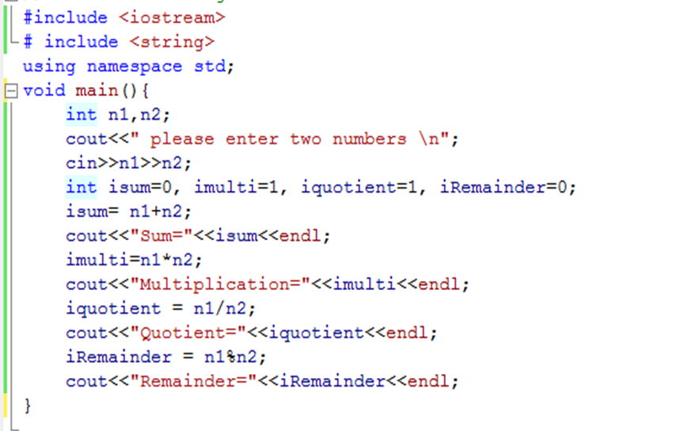
Calculator Program

Slide 27
Notes
Try to enter the second number 0, A Handled Exception will appear.
iquotient results is always integer:
That’s because of integer division.
To solve the problem, declare the variable to be of type float: float fquotient;
Typecast the division process to be of type float, since the two numbers divided by each other are integers, this typecasting urges the result to be a float number and thus the correct result will appear. fquotient = (float) n1/n2; à this called typecasting.

Slide 28
Conditions
Enter two numbers and display a message telling which is bigger.

Slide 29

Conditions
Enter two numbers and display a message telling which is bigger.

Slide 30
Conditions (cont.)
if(cond 1 is true) {
// execute code
}
if(cond 2 is true) {
// execute code
}
if(cond 3 is true) {
// execute code
}
if(cond n is true) {
// execute code
}
if(cond 1 is true) {
// execute code
}
else if(cond 2 is true) {
// execute code
}
else if(cond n is true) {
// execute code
}
else {
// execute code
}

Slide 31
Comparison Operators
==
!=
<
>
<=
>=
if (x == 100)
cout<< “X = 100” <<endl;
Here (==) is used for comparison which is unlike (=) used for assignment.

Slide 32
Example
Enter a number and display if it is equal to 10 or not.
int main()
{
int A;
cin >> A;
if ( A == 10 )
{
cout << "is equal" << '\n';
cout << "closing program" << '\n';
}
else
{
cout << "not equal" << '\n';
cout << "closing program" << '\n';
}
return 0;
}

Slide 33
The Same ?
if (x == 100)
cout << "x is 100";
else
cout << "x is not 100";
if (x == 100)
cout << "x is 100";
cout << "x is not 100";

Slide 34
Quiz
Enter two numbers and display a message telling which is bigger.
#include <iostream>
using namespace std;
int main()
{
// define two integers
int x = 3;
int y = 4;
//print out a message telling which is bigger
if (x > y)
cout << "x is bigger than y" << endl;
else
cout << "y is bigger than x" << endl;
}

Slide 35

Problem
Write a program to find the largest of three numbers A,B, and C.

Slide 36
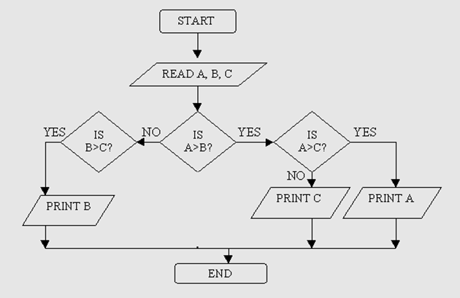
Answer
int a, b, c;
cin >> a >> b >> c;
if (a > b) {
if (a > c) cout << a << endl;
else cout << c << endl;
}
else {
if (b > c) cout << b << endl;
else cout << c << endl;
}

Slide 37
Can we do any better ?!
and &&
or ||

Slide 38
The new solution
before:
int a, b, c;
cin >> a >> b >> c;
if (a > b) {
if (a > c) cout << a << endl;
else cout << c << endl;
}
else {
if (b > c) cout << b << endl;
else cout << c << endl;
}
}
after:
int a, b, c;
cin >> a >> b >> c;
if (a > b && a > c)
cout << a << endl;
else if(b > a && b > c)
cout << b << endl;
else
cout << c << endl;

Slide 39
Cont.
&& → We need to check that two conditions are true in order to execute a statement.
if (X < max && x > min)
cout<< “x is within limits”;
|| → We need to check that either of two conditions is true in order to execute a statement.
if (G == ‘E’ || G == ‘e’)
cout << “ Students got Excellent degree” ;

Slide 40
Thank You!

